Slide 1
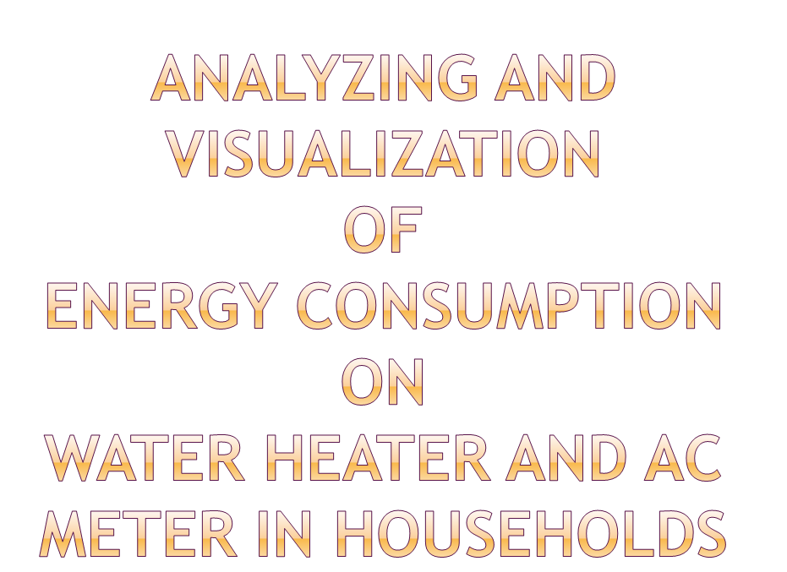
BY
AKANO, KESIDE
DATA ANALYST

Slide 2

PREFACTORY ANALYSIS
VISUALIZATION GRAPHS OF MODELING AND PREDICTIONS
INSIGHTS AND DISCOVERY
RECOMMENDATION

Slide 3

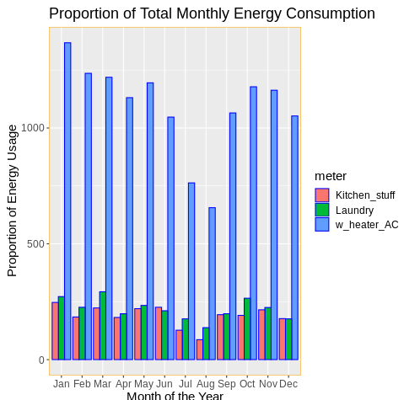

Slide 4

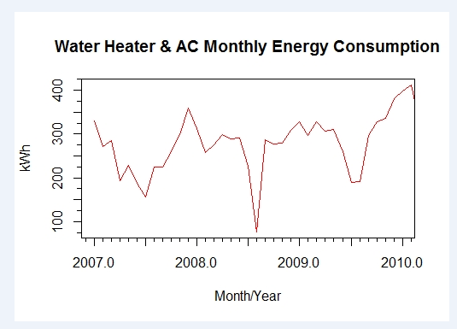

Slide 5

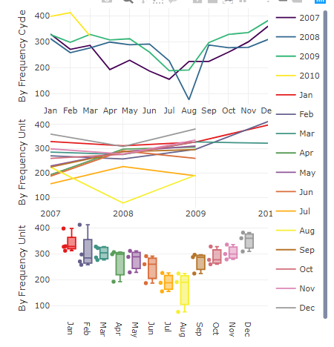

Slide 6

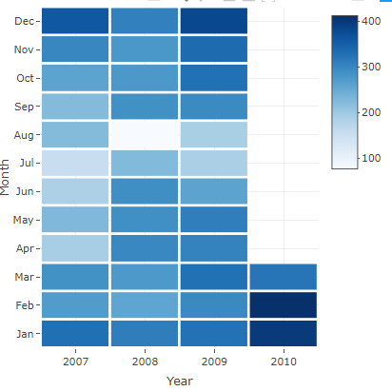

Slide 7

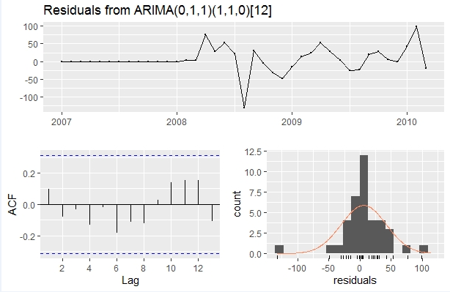
Ljung-Box test
Data: Residuals from ARIMA(0,1,1)(1,1,0)[12]
LM test = 4.5243, p-value = 0.6061
Training set error measures:
ME RMSE MAE MPE MAPE MASE ACF1
Training set 5.850819 36.04493 21.35182 -1.829402 10.35502 0.4178436 0.09885124

Slide 8

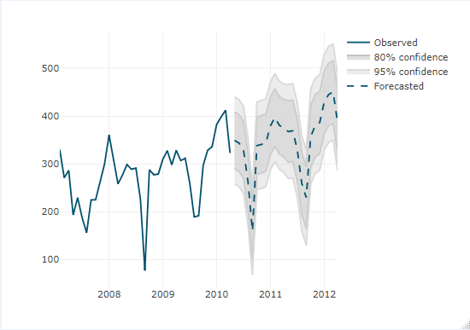
TWO YEAR FORECAST

Slide 9

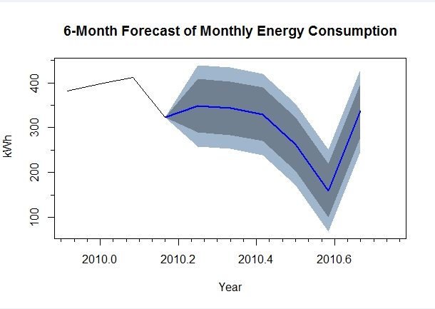

Slide 10

I advise the use of granularity visualization in the meters to uncover trends in the behavior of sub-meters to enable minimize the use of appliance.
Conclusion
Clients save energy and money from the first year with the use of the
Sub-meters.
With the data analysis of the sub-meters clients will be able to:
**Past Consumption:**
Check energy evolution by different submeter over different periods of time
Check the costs of any period of time
**Future predictions:**
Predict their bills by months ( total energy or sub-meters)
Predict their energy expenses over the years

Slide 11

‘Beware of little expenses because a small leak of it can sink a great ship’

Slide 12

